Slide 1
OSPI, Vadis and the Mukilteo School District
Job Foundations Community of Practice

Slide 2
OSPI Secondary Transition
Notes:
To support you in your efforts here we wanted to briefly review some of the transition guidance that is available to add this to your toolboxes.

Slide 3
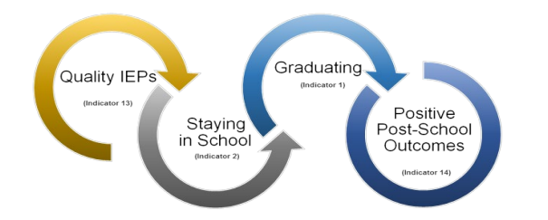
Critical Interrelationship for Achieving Post-School Outcomes
Source: Center for Change in Transition Services (2017). Writing effective transition plans, page 5. Graphic modified by CCTS from Kohler, Gothberg, and Hill. (2009). NSTTAC Evaluation Toolkit. National Secondary Transition Technical Assistance Center (NSTTAC): Western Michigan University.
WAC 180-51-220 (4)

Slide 4
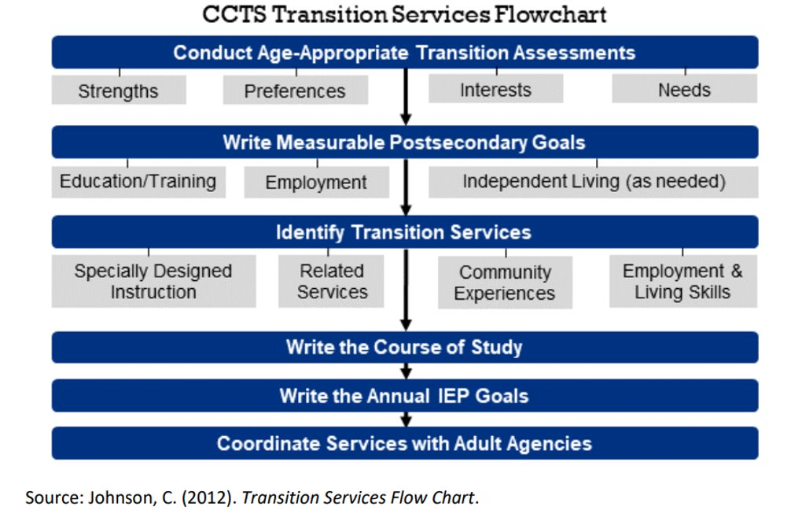

Slide 5
Transition Guidance to Add to your Toolbox
Notes:
To support you in your efforts here we wanted to briefly review some of the transition guidance that is available to add this to your toolboxes.

Slide 6
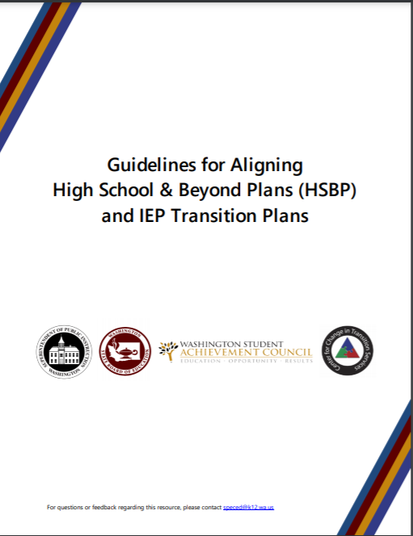
Guidelines for Aligning High School & Beyond Plans and IEP Transition Plans
Appendix A: The Transition Team Members and Roles
Appendix B: Sample HSBP and IEP Transition Plans
  Case Study of a 10th grader using a CTE Course Sequence - (Webinar)​
  Case Study of an Adult Student using the WA-AIM (Webinar)
Appendix C: High School Education and Training Opportunities
Appendix D: Post-Secondary Education and Training Opportunities
Appendix E: Post-Secondary Employment Options
Appendix F: Post-Secondary Outcomes (Indicators 1, 2, 13, and 14)
Appendix G: IEP Transition Planning Checklist for Educators
Appendix H: Transition Planning Checklist for Students
Appendix I: Transition-Planning Resources
Notes:
So many of the resources we will be highlighting today come from Guidelines for Aligning HSBP and IEP Transition Plans, you can see these bolded here. We know this isn’t new but this is so robust so we want to make sure this is in your toolbox

Slide 7
Appendix A: The Transition Team Members and Roles
Parents and Families
Collaboration is essential for effective transition planning
  Adult services agencies are essential partners for transition planning
  All means all- and employment and job readiness support apply to all students
Students are the most important member of the transition team and their meaningful participation is key
Students with IEPs get same HSBP planning, with similar staff, as all other students*
And Others
School Counselors
Community Partners
Special Education Staff
Student
Employers
General Education Teachers
Adult Service Providers
Paraeducators
School Psychologist
Related Services and Support Staff
WAC 180-51-220 (4)
Notes:
So the first appendix I wanted to highlight is appendix A: Transition Team members and roles.
This resource has a wealth of information about the different transition partners and roles that can be really helpful when reviewing your local transition teams and processes.
A few points I want to make here is that:
Collaboration is essential including the role of adult service agencies on the transition team
Students are also the most important member of their transition team and their meaningful participation is key
Programs like job foundations can really help to bring these teams together to support students. Additionally programs like job foundations really help to build up a system capacity to team, collaborate and support students.
A very exciting time in transition as we have great partnerships at all level to really have robust collaborative and supportive transition planning for students. The whole team has a role in putting together supports for a student's to be ready for employment after school.
OSPI has a role in supporting best practices, guidance and teaming, and schools and teams really have a role making sure employment preparation is available to all students and that they are making the valuable connections to our adult service providers and valuable programs like school to work and job foundations.
(Kick off to Rod to add some content)

Slide 8
What should I expect from the Secondary Transition Process at School?
The IEP Transition Plan should be a student centered and collaborative effort that is in place no later than a student’s 16th birthday. Students should also have a High School and Beyond Plan that begins by grade 8.
IEP teams should be supporting connections with Washington State adult service agency's early in the IEP process.
Transition services as well as a graduation date and plan must be an individualized decision based on a student's unique disability related needs not based on the school schedule or model

Slide 9
Secondary Transition Recommendation
It is best practice to begin discussing, planning, and working towards transition in middle school or earlier.
Utilize Student Led IEPs
Support students to understand, report on the usefulness and advocate for the accommodations and modifications in the IEP
Utilize work-based learning opportunities that align with a student’s post-secondary goals help students engage in career exploration as well as to develop self-advocacy and other employment skills

Slide 10
Transition Resources
Engage in the resources found on the OSPI Secondary Transition webpage
Reach out to the IEP team first and then the Special Education Director if needed
  Special Education Directory
Connect to support to increase productive collaboration with the IEP team
  Special education parent liaison support
  No cost IEP meeting facilitation and IEP mediation
Contact OSPI for questions you may have:
  For special education questions: speced@k12.wa.us
Notes:
Alex

Slide 11

Thank you
Notes:
Tania

Slide 12
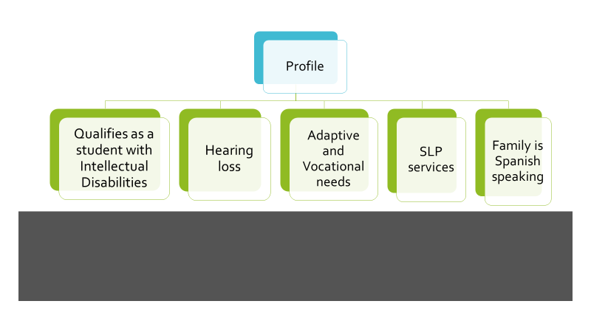

Slide 13
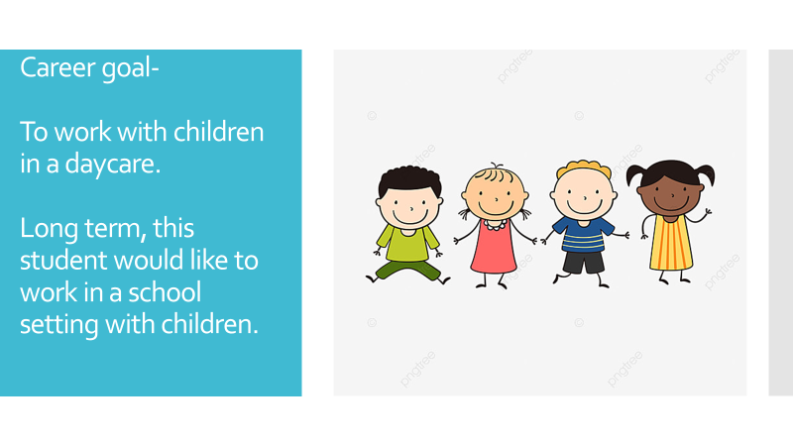

Slide 14
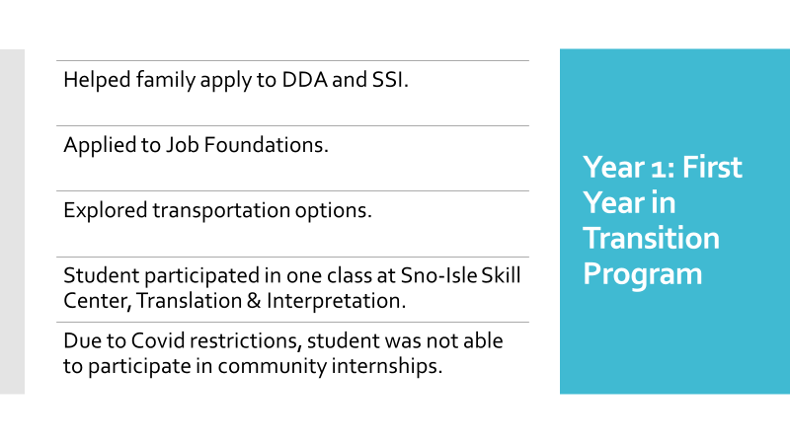

Slide 15
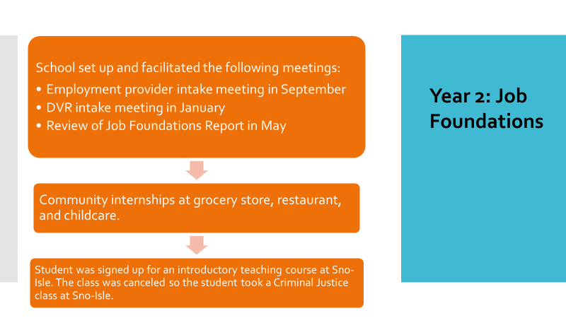

Slide 16
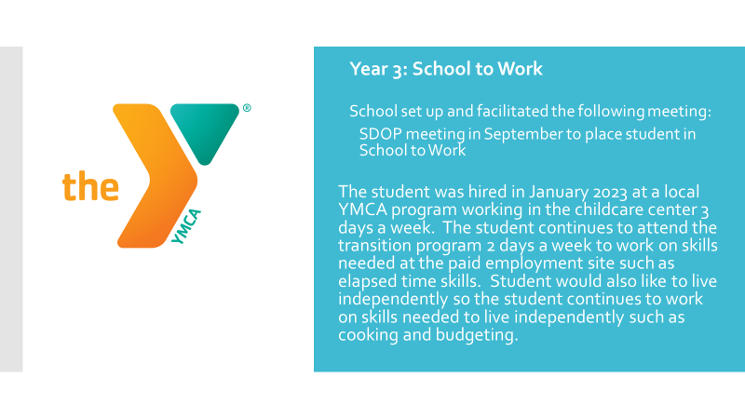

Slide 17
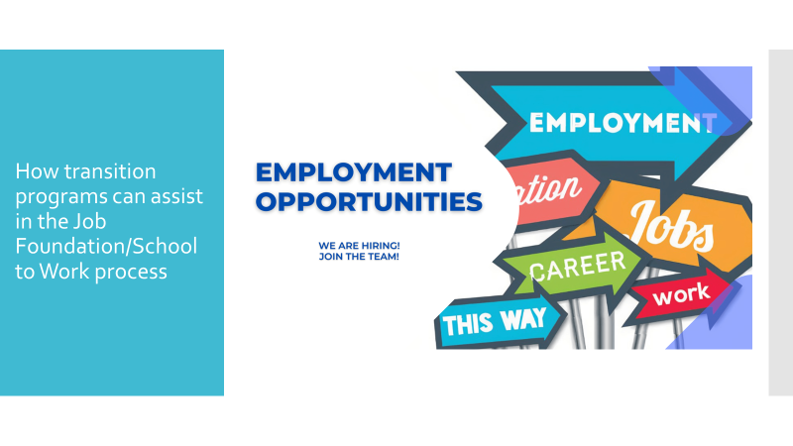

Slide 18
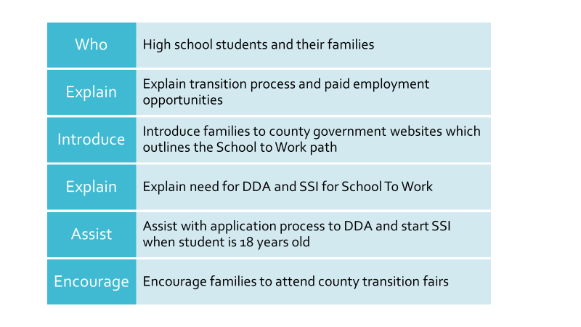

Slide 19
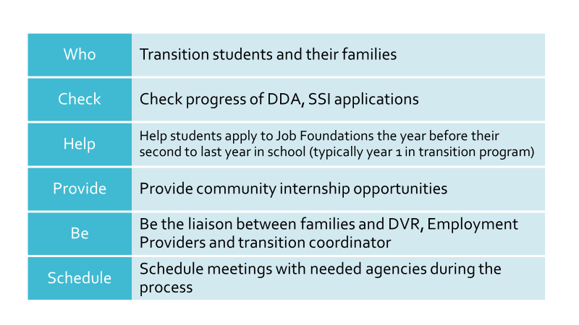

Slide 20


Slide 21
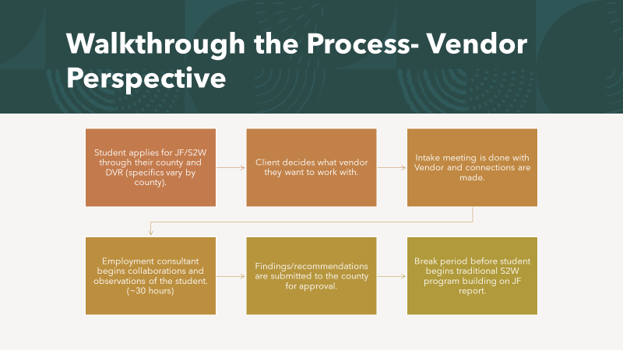

Slide 22
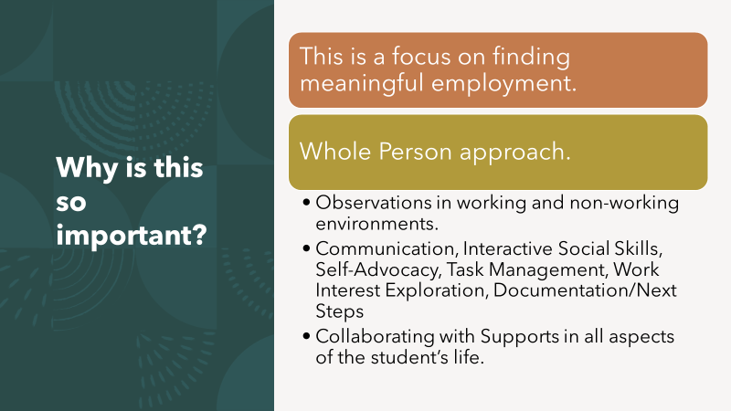

Slide 23
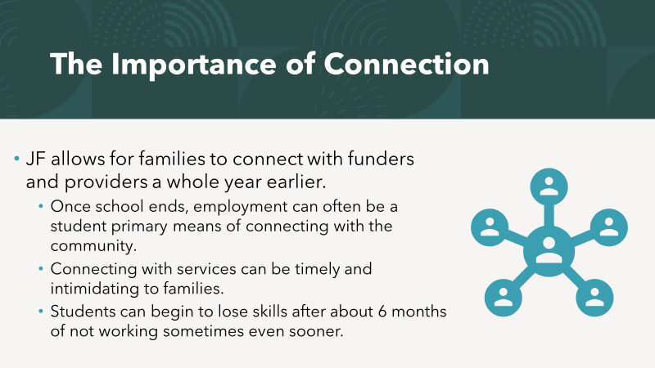

Slide 24
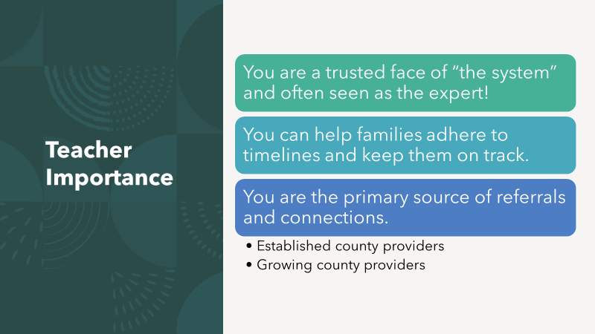

Slide 25


